Slide 1

Customer Segmentation for Strategic Marketing
ADEYEMI ADEROJU
November 2024

Slide 2

OUTLINE
02
Results
04
0
Introduction
Customer Segmentation
Recommendations
01
03

Slide 3





Introduction
Objective
The primary goal of this project is to segment customers and develop targeted marketing strategies based on these segments.
Methodology
Two methods adopted are:
RFM Analysis: used for Initial customer segmentation based on Recency, Monetary and Frequency scores.
K-Means Clustering: Used to refine segmentation by identifying clusters based on RFM values and other data.
**RFM: Recency, Frequency, Monetary

Slide 4
Customer Segmentation
SEGMENTATION PROCESS
Phase
Key Activities
EVALUATION CRITERIA
Remove empty rows
Drop duplicates
Change datatype for CustomerID and InvoiceDate
Drop cases where Quantity <0 or Price < 0 (i.e., cancelled orders)
Remove cases where CustomerID is missing
Feature engineering( Revenue, Average Basket Size, Age etc.)
Data Cleaning
&
Preprocessing
Handle missing data holistically
Apply standardization with features that have different scales.
Check and remove duplicate entries to maintain data integrity
Ensure cleanliness, completeness, and relevancy.
Derive Recency, Frequency, and Monetary Values
Assigned scores to the RFM values using Quantile-base discretization
Create a combine RFM score by concatenating the scores
Assign the combined score to the customer based on their RFM scores
Replace the scores with labels accordingly
RFM
Analysis
Ensure the segmentation logic is set up to create distinct groups without significant overlap.
In addition to the RFM values, obtain Average Basket Size and Age for each customer.
Define a pipeline for variable transformation (Continuous: scale and Categorical: One-Hot Encoding )
Choose k (number of clusters) using Elbow plot and Silhouette scores.
Train the model using k and the pipeline.
Predict score and label customers based on average RFM values.
K-means
Clustering
Absence of outliers
No strong relationship between variables under study
Data must be standardized
k value must give a strong balance of a lower SSE (from the Elbow plot) and a high silhouette score

Slide 5
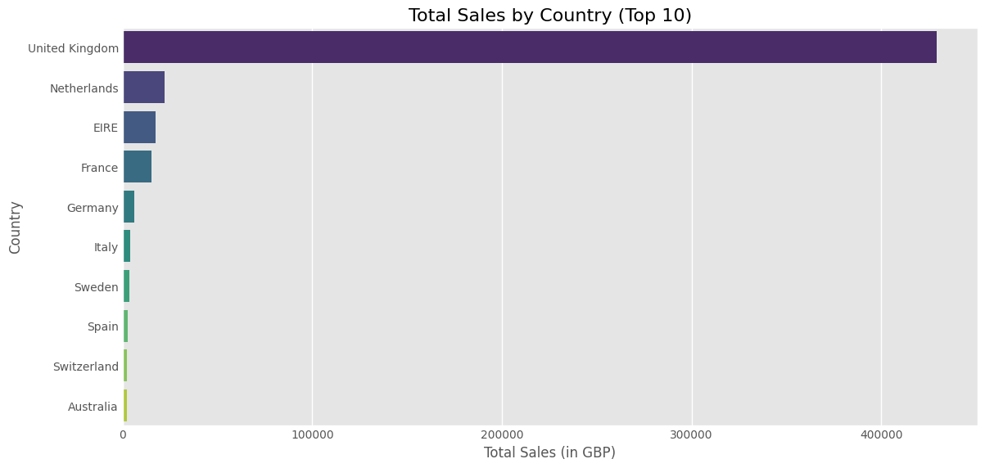
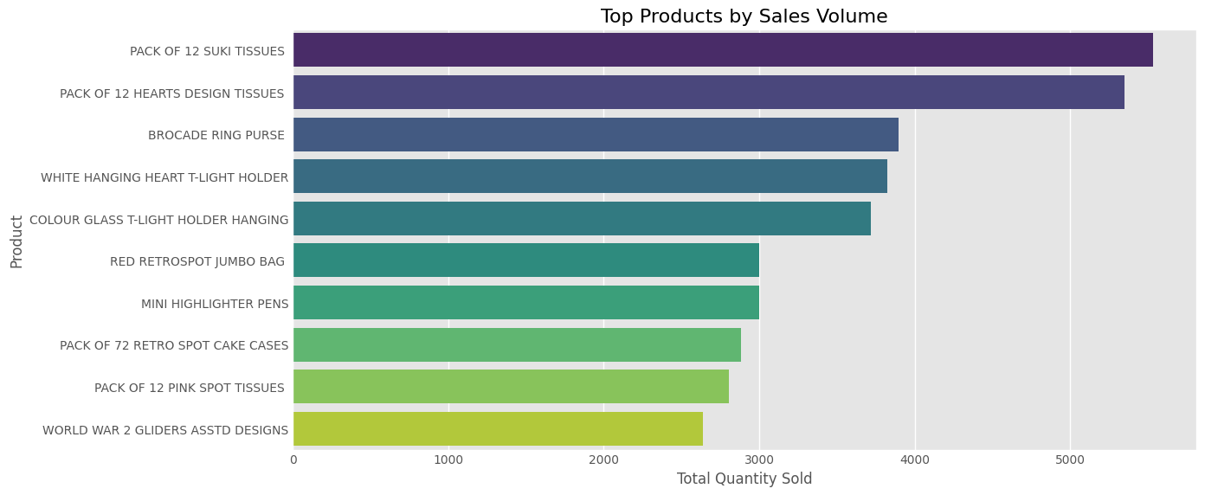

Exploratory Data Analysis (EDA)
UK is the most significant market based on sales and number of customer, followed by Netherlands and Ireland
PACK OF 12 SUKI TISSUES is the flagship product for the company and, is the most popular product in United Kingdom

Slide 6
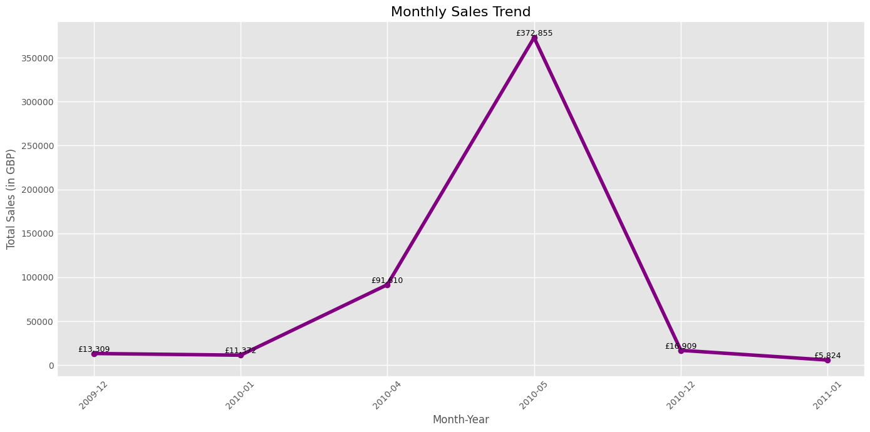
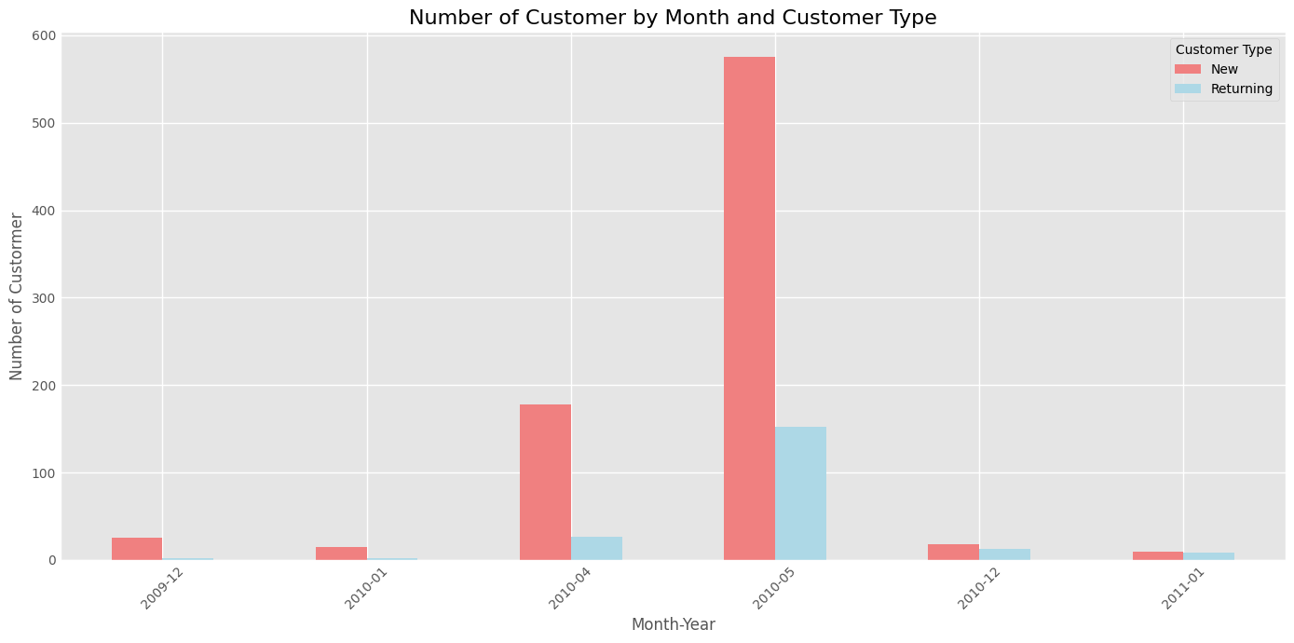
Exploratory Data Analysis (EDA) (Cont’d)
The company experienced the highest sales in the month of May, in 2010, and the lowest in January 2011. The high sales in May, 2010 can be attributed to the company’s effort in recruiting new customers, and maintaining existing ones.

Slide 7

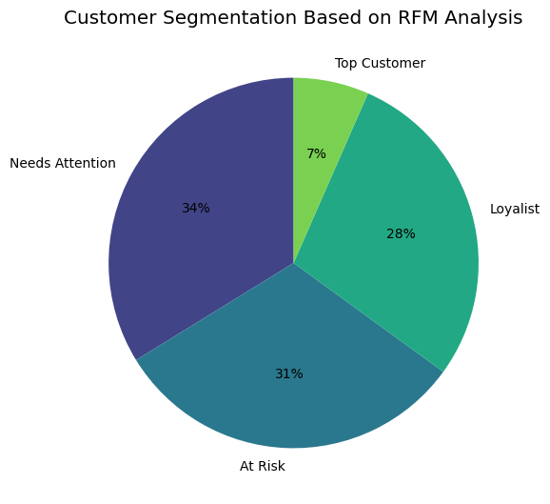
Results From RFM Analysis
Based on the RFM Analysis, 31% of the customers have not returned to make a purchase, indicating a risk of them becoming inactive or lost. The Ecommerce Company has just 7% Top customers, while 28% are Loyalist and 34% of the customers are at the verge of becoming inactive or lost

Slide 8
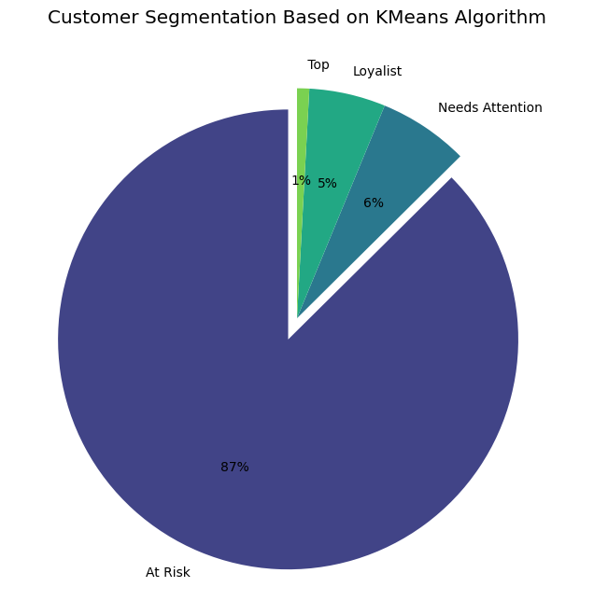
Results From K-Means Clustering
The Top Customers are 1% of the customer-base, while Loyalists, and customers that are at risk of churning or need attention make up 5%, 87% and 6% (approx.) respectively

Slide 9
Results From K-Means Clustering (Cont’d)
Cluster Distribution By Country
 | Top | Loyalist | Needs Attention | At Risk | Total
United Kingdom | - | 44 | - | 717 | 761
Australia | - | - | 4 | - | 4
Austria | - | - | 1 | - | 1
Belgium | - | - | 3 | - | 3
Channel Islands | - | - | 1 | - | 1
Cyprus | - | - | 1 | - | 1
Ireland | 2 | - | - | - | 2
Finland | - | - | 1 | - | 1
France | - | - | 14 | - | 14
Germany | - | - | 10 | - | 10
Greece | - | - | 2 | - | 2
Italy | - | - | 4 | - | 4
Netherlands | 5 | - | - | - | 5
Portugal | - | - | 1 | - | 1
Singapore | - | - | 1 | - | 1
Spain | - | - | 3 | - | 3
Sweden | - | - | 1 | - | 1
USA | - | - | 2 | - | 2
Switzerland | - | - | 3 | - | 3
Total | 7 | 44 | 52 | 717 | 820
Whereas United Kingdom is the hottest Market in terms of Revenue, all the Top Customers are from other countries such as Ireland and Netherlands. Most of the customers in UK are at risk of churning

Slide 10


Cluster Key Metrics
Top Customers
Top-spending, high-frequency bulk buyers. They make significant contributions to overall revenue with their consistent, large purchases
At Risk
low engagement, low-spending customers who have not purchased in a while
Cluster Metric Scores
Cluster | Recency | Frequency | Monetary | ABS
Top Customers | 210 | 3.4 | 5,593 | 1,006
Loyalist | 26 | 2.59 | 1,438 | 316
Needed Attention | 243 | 1.37 | 836 | 378
At Risk | 244 | 1.31 | 510 | 229
Loyalists
active and valuable due to their frequent purchases and high spending
Need Attention
Bulk buyers who make substantial purchases but are not very frequent buyers. They may buy in bulk for occasional stock-ups
**ABS: Average Basket Size

Slide 11

Recommendations
Offer tailored services, personalized communication, and priority customer service.
Consider special loyalty programs or premium product access to keep them engaged.
Top Customers
Use special bulk promotions and reminders to re-engage them for repeat bulk purchases
Promote bulk-buying discounts and periodic promotions or special deals for items they purchase in large amounts.
Needed Attention Customers
Offer loyalty rewards, early access to products, and exclusive deals to maintain engagement and increase spending.
Provide targeted campaigns for repeat purchases to enhance their loyalty.
Loyalists
Reach out to these customers with targeted offers, reminders, or new product promotions to bring them back
Offer incentives for frequent purchases to encourage long-term engagement.
Customers At Risk of Churning

Slide 12

THANK YOU

